Slide 1
Indigenous Knowledge and Collaboration in the Yukon-Kuskokwim Delta Region, Alaska
Challenges in Establishing a more
Holistic Woldview
Association of Village Council Presidents
Steven R. Street, Director
Dept. of Cultural and Environmental Sciences
Arctic Council &
Sustainable Development Working Group
Inupiat Heritage Center
November 27, 2017
Utqiagvik, Alaska

Slide 2
Categories of Concern - Where Do We Want to be in 50 years?
Air Quality
Water Quality
Noise Pollution
Erosion
Water-based Resources (Fisheries)
Land-based Resources (Plants, Animals & Places)
“Social Justice” (Economic development ~ Who wins and who looses?)

Slide 3
Development and Environmentalism
Multinational Corporations, rather than governments, are affecting national economies around the world
Native people are suspicious of Western environmentalism
Core nations destroyed their own environments and now want to restrict development elsewhere
Native people need basic services, like electricity and sewer systems
Limited consultation with Native people leads to the “underdifferentiation” of Native views
Development and environmental plans often threaten indigenous people

Slide 4
“Resilience?”
Vulnerability – a risk
Hazard – a threat
Impact – an effect
Resilience – response and recovery
“Cyclicity, variability, predictability”
(Cooper 2012)

Slide 5
“Sustainability?”
Sustainability of what?
- define your terms!
- unit of measurement and scale
Sustainability for whom?
- Native people?
- Rural people?
- The planet?
Sustainability at what cost?

Slide 6
2016 AVCP Tribal Priorities (identified by 56 member tribes)
Public Safety
Economic Development
“Community Wellness”
- Healthy Families
- Suicide Prevention
- Qasgiq Model

Slide 7
“Traditional” Knowledge? “Indigenous” Knowledge? “Local” Knowledge? “IQ” (Inuit qaujimajatuqangit)?

Slide 8
Strengths of Traditional Ecological Knowledge:
Extended time depth
Holistic
Intimate
Participatory
Experiential, not Generalizable
“Memory culture” (elder knowledge and interpretation)

Slide 9
Knowledge has Purpose!
“Tacit” Social and Political Motivations:
Notes:
We don’t usually invest effort in creating and transmitting knowledge to others without some purpose
Most of what we know about our own culture is “tacit” – we know deep down how things are but we often can’t express our knowledge effectively to others

Slide 10
1. Local consumers of historical, social and philosophical knowledge
Retain/preserve what you feel is valuable from your understanding of your own history
Reinvigorate practices that have fallen into disuse or have been lost
Produce materials to enculturate (educate) either “insiders” or “outsiders”

Slide 11
2. Contrast to/Opposition to Western scientific worldview
Generally rejects the Western Scientific worldview
Proposes an alternative method of learning and gaining/creating knowledge
Indigenous knowledge should be given “equal time” and status

Slide 12
3. Complement Western scientific worldview
Generally accepts that Western science produces legitimate knowledge
Western scientific methods overlook significant processes or variables
Local knowledge can supply the missing elements

Slide 13
Helping, Sharing & Giving! Values-based decisions vs. Rules-based decisions

Slide 14
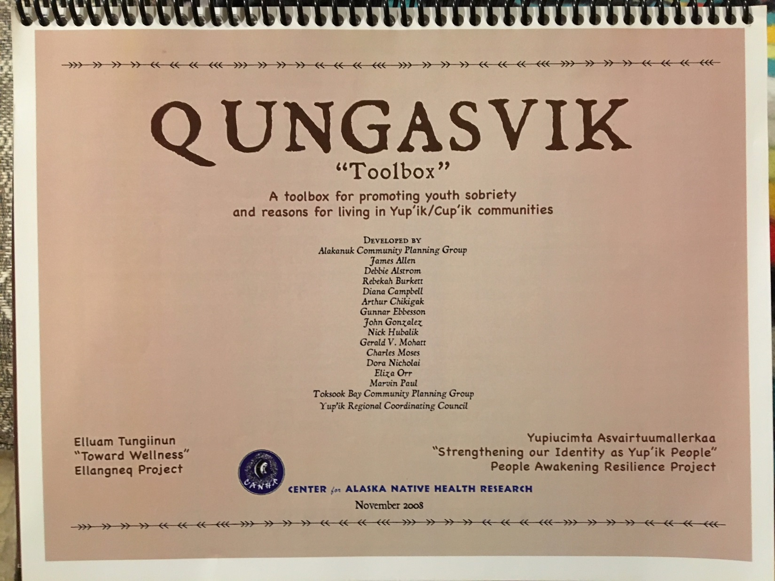

Slide 15
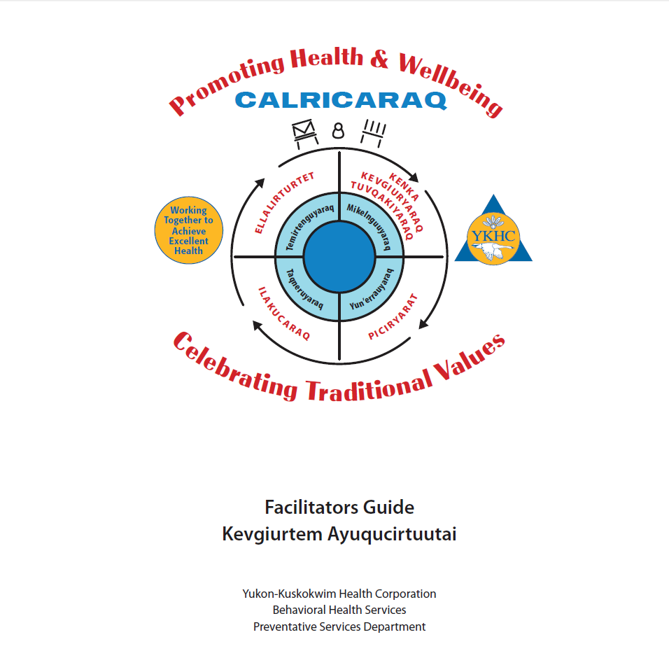

Slide 16
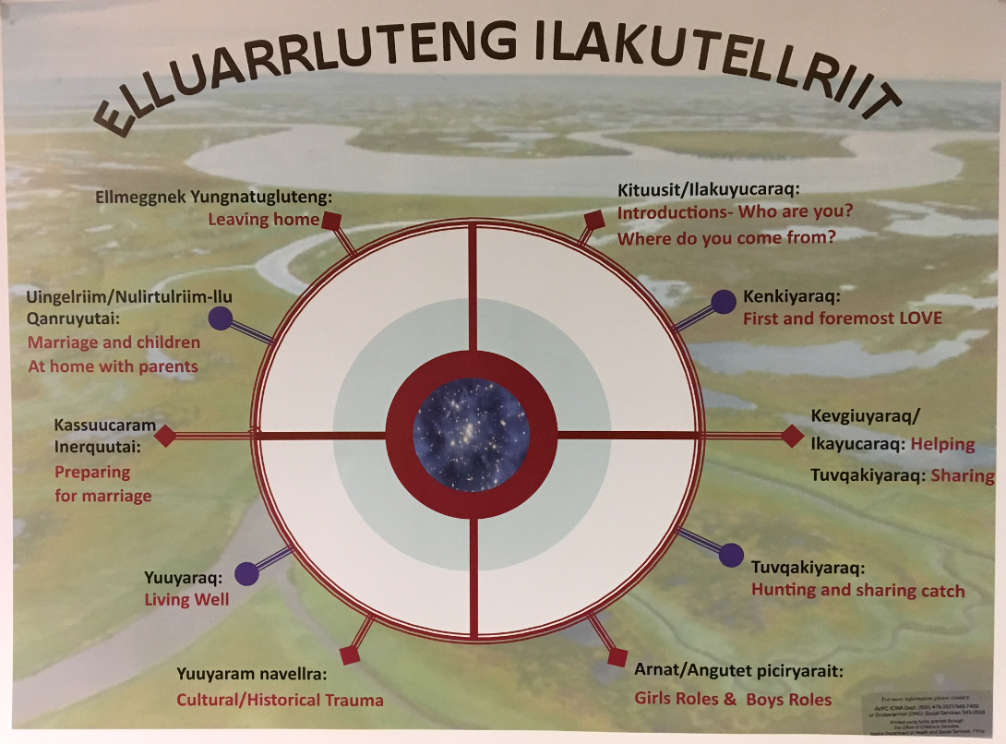

Slide 17
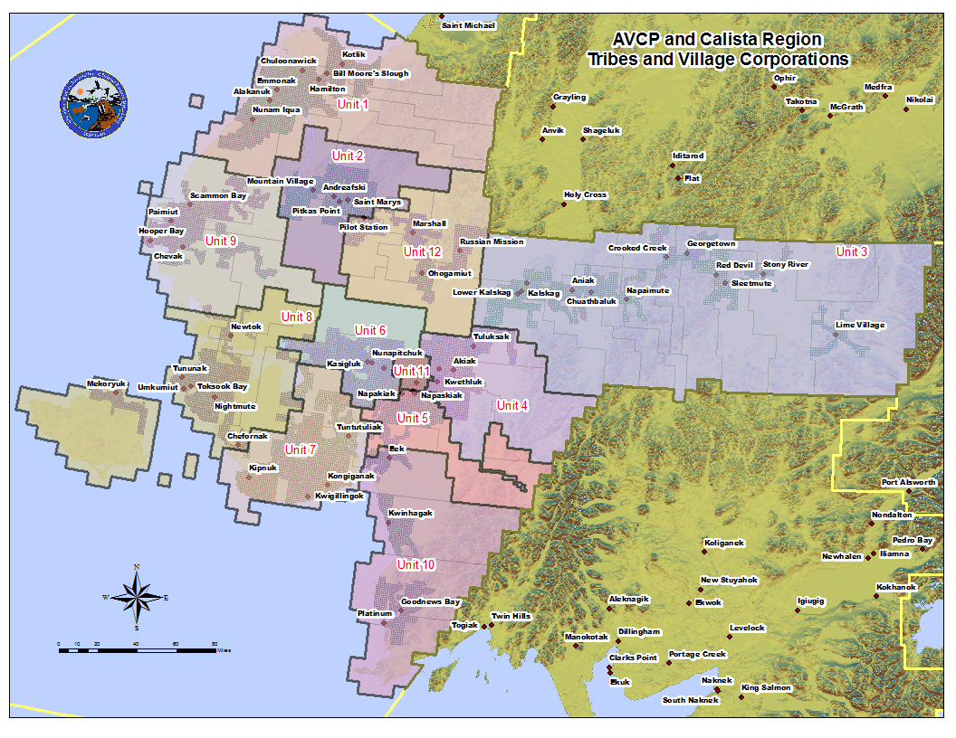

Slide 18
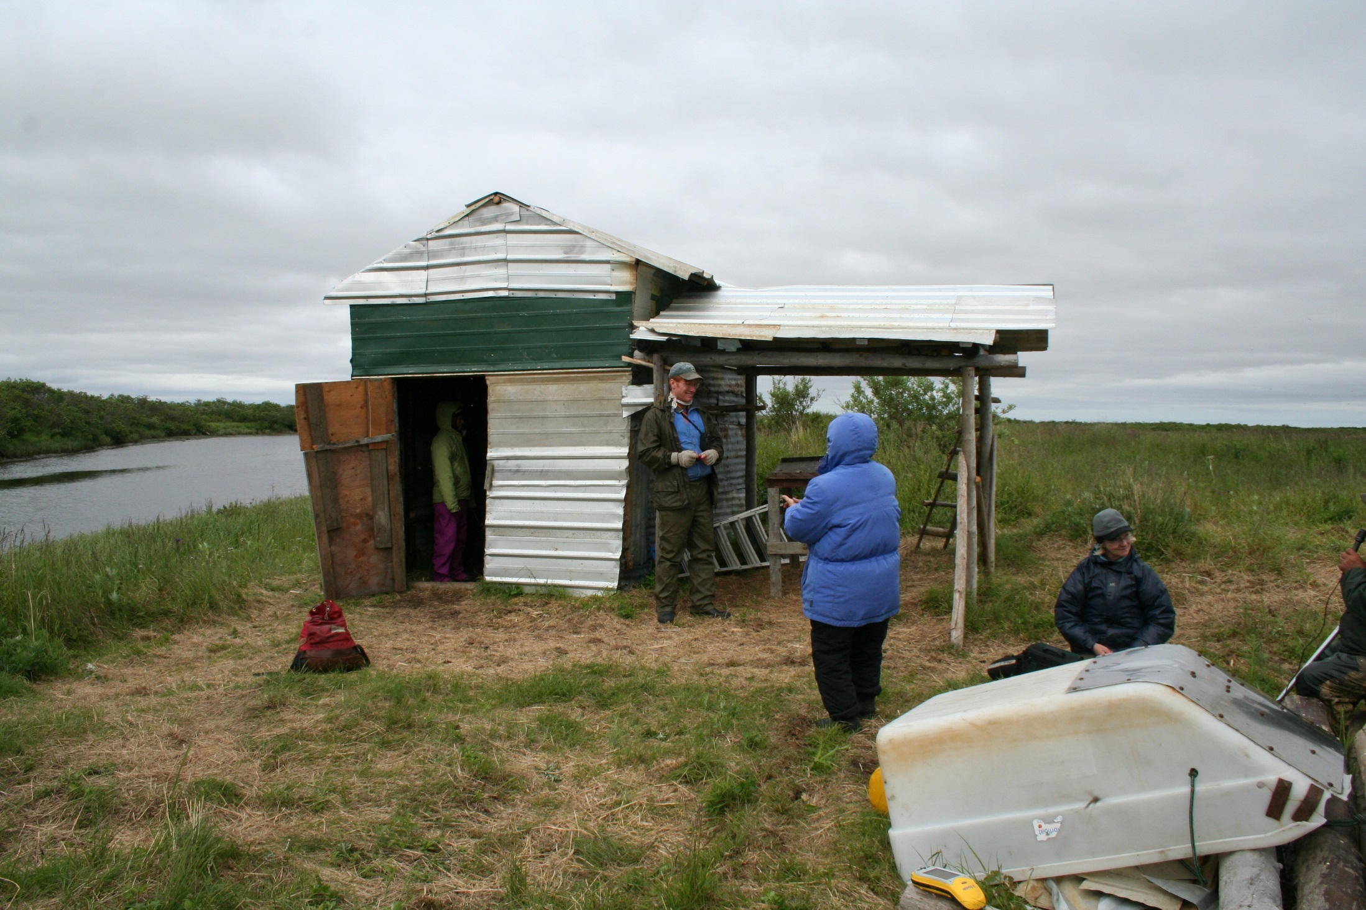

Slide 19
https://eloka-arctic.org/projects/yupikknowledge.html/

Slide 20
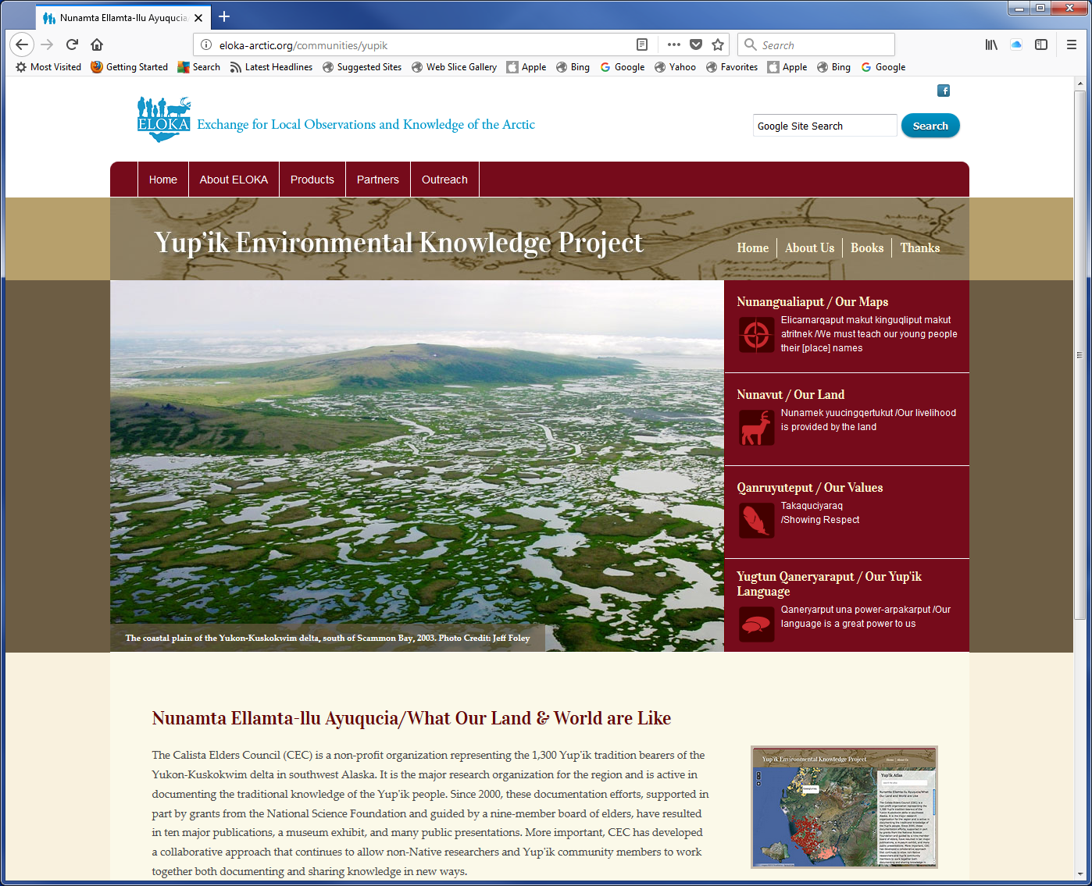

Slide 21
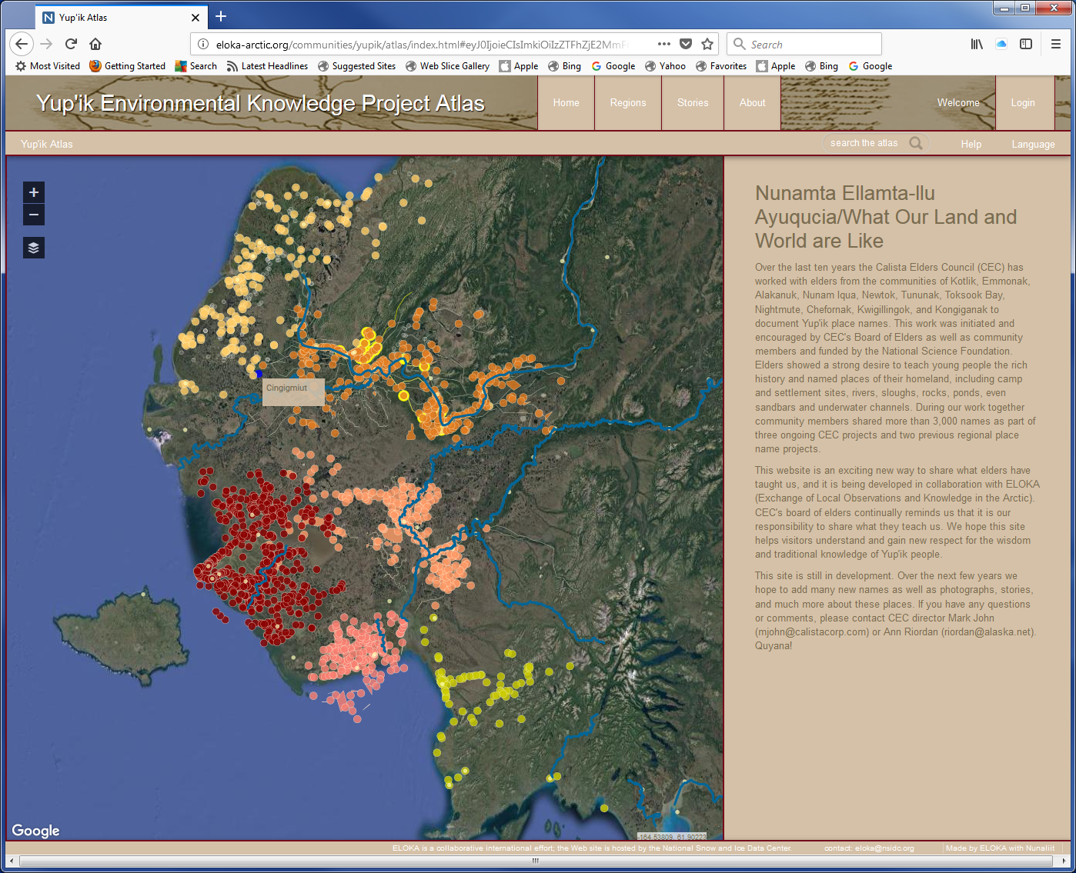

Slide 24
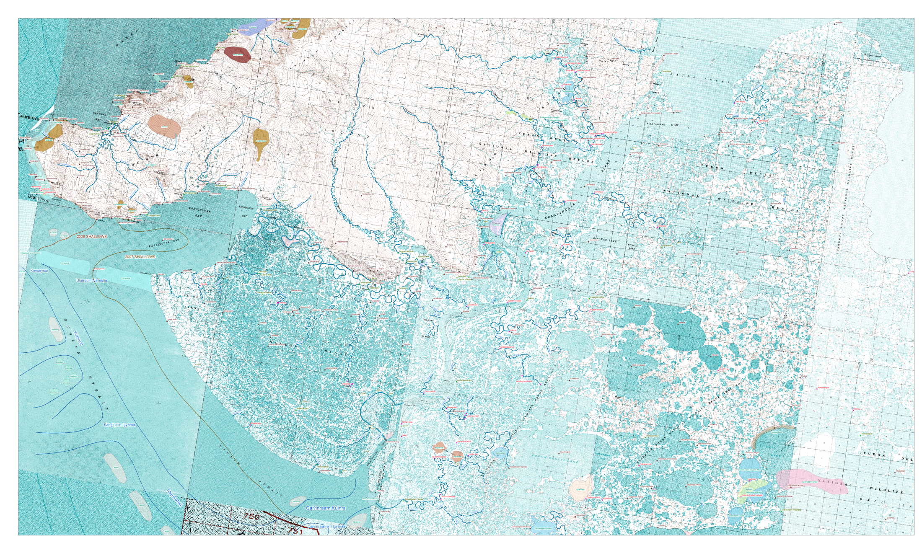

Slide 25
