Slide 1
Meaningful Engagement with Indigenous Peoples
Environmental Impact Assessment in Alaska and Across the Arctic
Indigenous Engagement In U.S. Arctic
________________________
Bureau of Ocean Energy Management
Arctic Offshore Experience

Slide 2
Environmental Impact Assessments (EIAs)
EIA = Environmental Impact Statement (EIS)
- Mandated by the National Environmental Policy Act 1969 (NEPA)
- BOEM is the lead agency responsible to prepare EIS’s
International Context:
- Strategic EIA ≈ BOEM Programmatic National Oil & Gas Program
- Regional EIA ≈ BOEM Lease Area EIS
- Project EIA ≈ BOEM Development Plan EIS
Notes:
National Environmental Policy Act of 1969 requires an environmental review process for major actions that are proposed, approved, regulated, or funded by federal agencies. In the United States an EIA is called an Environmental Impact Statement (EIS).
- For Federal offshore oil and gas, the Bureau of Ocean Energy Management initiates an EIS early in the process at several stages beginning with the planning for proposed Five-Year Oil and Gas Leasing programs (Programmatic EIS), proposed lease sales (Sale Area EIS), and requests from industry to approve oil and gas plans or permits (Project EIS).
- These three phases are roughly equivalent to a Strategic EIA, Regional EIA, and a Project EIA. The Government assumes full responsibility for funding and development of the EIS.

Slide 3
Engagement Process
Geographic Scope
Engagement is Key – Tribes, Public, and Governments
Multiple steps, decision points, and opportunities for input during each phase
Entire process spans years
Five Year Program
YEARS
Lease Sale
Exploration
Development
EIA Workshop Utqiaġvik, November 27-29, 2017

Slide 4
Engagement
Additional science and traditional knowledge
Process may require more information
Process may require multiple environmental reviews
Potential Activity
Environmental Studies/
Research
Environmental Analysis/ Mitigation
(EIS)
Decision
Biological Sciences
Physical Sciences
Environmental Laws
Social Sciences
Traditional Knowledge
Existing sources of data and information
Consultations
(Legal Requirements)
Government-to-Government
Consultations (Tribal)

Slide 5
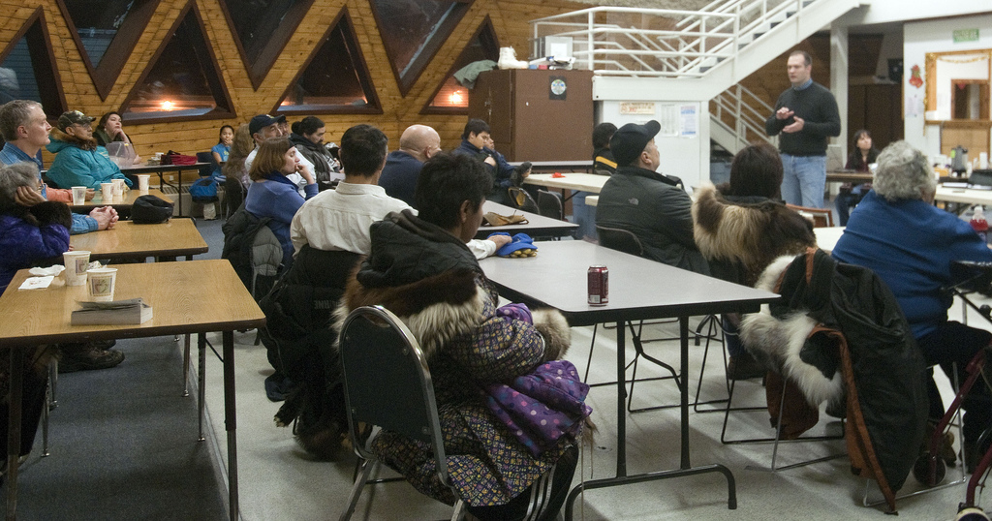
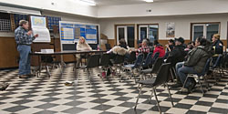

- Public Involvement – community scoping meetings, listening sessions, official hearings, etc.,
- Public reviews and comment periods
Engagement Opportunities

Slide 6
- Consultation is mandated by Executive Order 13175 on Government-to-Government Consultation with
Tribes and Native corporations
- Supported by U.S. Department of the Interior
Secretarial Orders, Guidance and Practices
- BOEM engages through formal consultations and / or informal meetings – dependent upon requirements and circumstances
Consultations

Slide 7
Role of our Tribal & Community Liaison Officer
Indigenous Engagements in Arctic
Establish, develop and maintain relationships with Tribes, communities, Native corporations, and other groups
Inform communities, tribal and community leaders, and partners about current and proposed activities, such as: public meetings, listening sessions, and special events like “A Night of Science in the Beaufort Sea’
Notes:
Establish and develop relationships with Tribes, communities, and village & regional corporations that want to have relationships.
- Provide range of routine information – not just time critical or sensitive materials – but a regular flow dependent upon each situation (no two are alike)
Public Notifications and Community Awareness Efforts
Purpose: Inform communities, including tribal and community leaders, and stakeholders about public hearings

Slide 8
Role of our Tribal & Community Liaison Officer
Indigenous Engagements in Arctic
Collaborate and assure appropriate public notice(s) are provided thru:
  Federal Register Notices
  Social Media Posts – Community Advisories
  Print Display Ads in daily / weekly newspapers such as Arctic Sounder, Nome Nugget, Fairbanks News-Miner, Alaska Dispatch News,
  Alaska Journal of Commerce, Peninsula Clarion.
Outreach prior to public meetings – assure collaborative distribution of:
  press releases, fliers, advisories and ads into and thru appropriate media to include newspapers, radio / television stations, BOEM website, social media, online notices, emails, messaging, phone calls
Outreach: tribes, communities, Native corporations, and others:
  for the benefit and uses for and by tribal and community groups
Notes:
TCL assures internal collaboration that benefits the tribes, communities and ANCSA corporations through effective use of:
- Public Notice(s) in the Federal Register Reading Room – such as with Draft EIS Notice of Availability postings
- Social Media Posts – Community Advisories
- Prints Ads – ads placed in dailies and weeklies, between two and three weeks prior to the public hearings to include, for example: Alaska Dispatch News, Peninsula Clarion Newspaper, Arctic Sounder, etc.,
- Fliers – created from print ads and used as hand bills (reminders) to selected groups, individuals prior to public meetings
- Press Releases – Distributed widely to tribal and community groups, newspapers, radio/television stations, BOEM website, social media, online,.
- Broadcast Outreach includes – Media Advisories, Radio Public Service Ads, Radio & TV Interviews
KEY MESSAGES / TALKING POINTS Examples, may include, but are not limited, to:
- BOEM uses a rigorous evaluation process based on the best and most recent science available in preparing an EIS
- Proposed lease sale is part of Department’s Outer Continental Shelf (OCS) Oil and Gas Leasing Program, which makes available for exploration and development federal OCS areas containing undiscovered, technically recoverable oil and gas resources
- BOEM remains in close coordination with Alaska Native tribal governments, local communities, the State of Alaska, as well as with other partners and stakeholders throughout process
- BOEM continues to take a careful, balanced approach toward leasing in the Alaska OCS Region

Slide 9
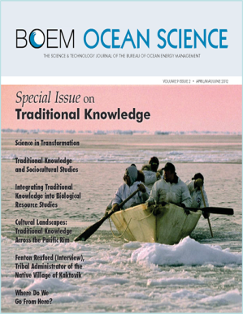
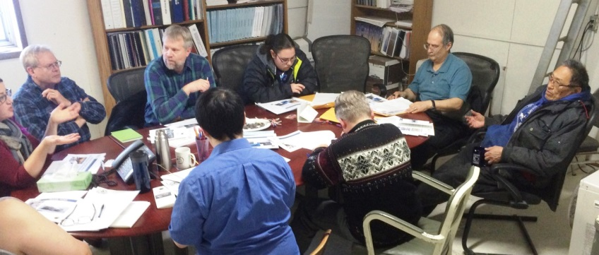
Traditional / Indigenous Knowledge
“A body of evolving practical knowledge based on observations and personal experience of local residents over an extensive, multi-generational time period”
BOEM Ocean Science Journal, 2012
  Linked to places
  Shared
  Respected
  Anchors values and identities
  Emphasizes unity between people and places

Slide 10
Traditional / Indigenous Knowledge
We treat traditional knowledge and science as complementary.
Equally valuable;
Provide a more complete picture together
BOEM actively seeks TK / IK
Complement the science
Strengthens decision-making
  TK / IK Informs Analysis and Decisions:
Understanding of the environment
Possible alternative actions
Potential impacts to subsistence activities
Mitigation measures to avoid or minimize potential impacts
EIA Workshop Utqiaġvik, November 27-29, 2017

Slide 11
Indigenous Engagement in Arctic EIA
Our Best Practices
  Show respect for values and traditions
  Active listening
  Collaboration
  Engagement – frequent conversations
  Exchange of reports and findings
    “It’s all about sharing” (Harry Brower)
  Benefits
  Produces more inclusive decisions
  Creates mutual understanding
  Enhances respect for both worldviews
  Allows more complete use of information
EIA Workshop Utqiaġvik, November 27-29, 2017
Notes:
For years our engagement with the tribe was more focused on ethnographic methods.
While this is important and useful, BOEM has gone beyond this to not only include ethnography but also explore and appreciate their epistemology in order to work together as partners.

Slide 12
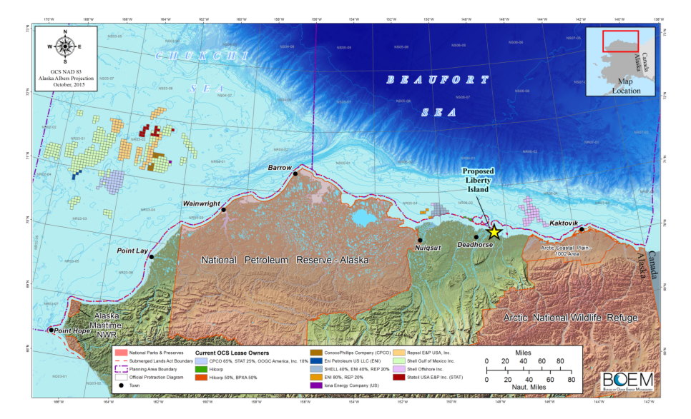
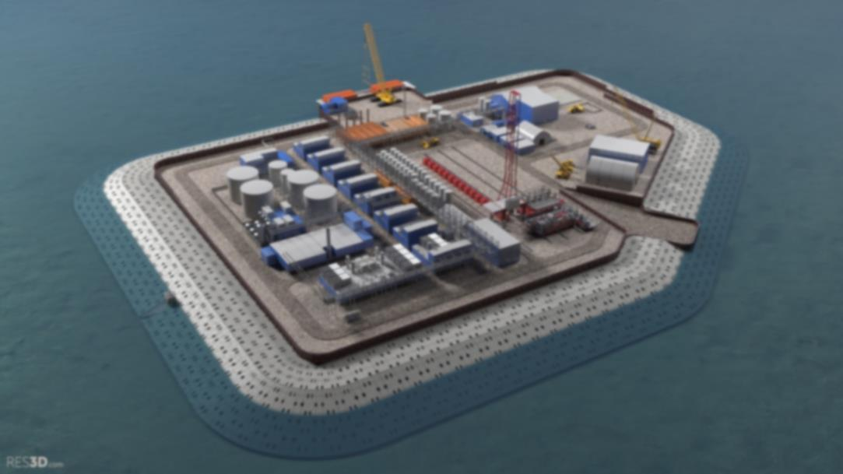
Liberty Project
  Artificial Gravel Island, 5.6 miles offshore
  Drilling & Production Processing Facility on Island
  Single Phase Oil Pipeline to Shore
  Peak Production Estimate 60,000 - 70,000 barrels/day
  16 well slots: 5-8 producers, 4-6 injectors, 2 disposal wells
Liberty
  First Production Anticipated 2020/2021
  Total Recovery Estimate 80 - 150 Million Barrels
  Project Life 15 - 20 Years

Slide 13
Liberty Project EIS
  Use of Traditional / Indigenous Knowledge
Whalers identified potential conflicts between fall whaling and development of a gravel island in Beaufort Sea
Mitigation measures provided by whalers were described in draft environmental impact statement
  Set quiet periods during whale migration and harvest
  Winter construction to proactively avoid and minimize conflicts
  Marine Mammal Observers on vessels to avoid animals
  Limited vessel speeds and routes to minimize potential impacts

Slide 14
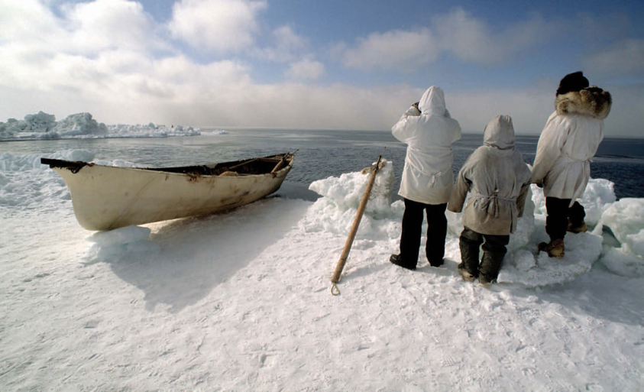

Quyana
Notes:
THANK YOU.
QUESTIONS. . .

