Slide 1
Local Collaboration in Alaskan Arctic Developments
Teresa Imm
Executive VP, Regional & Resource Development
Arctic Slope Regional Corporation

Slide 2
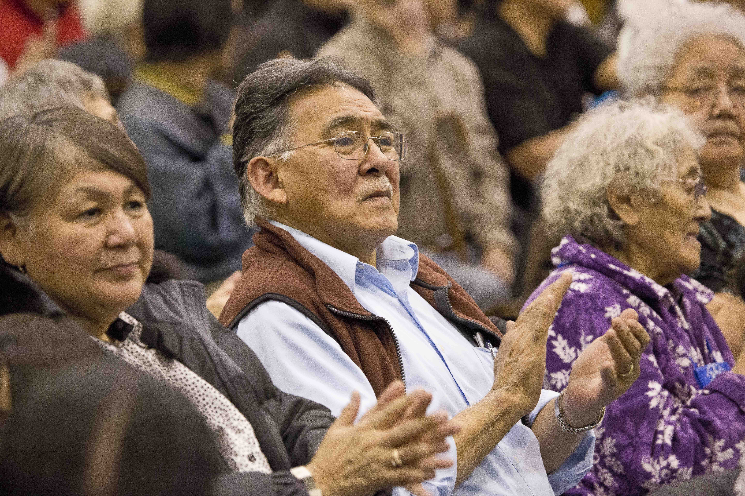
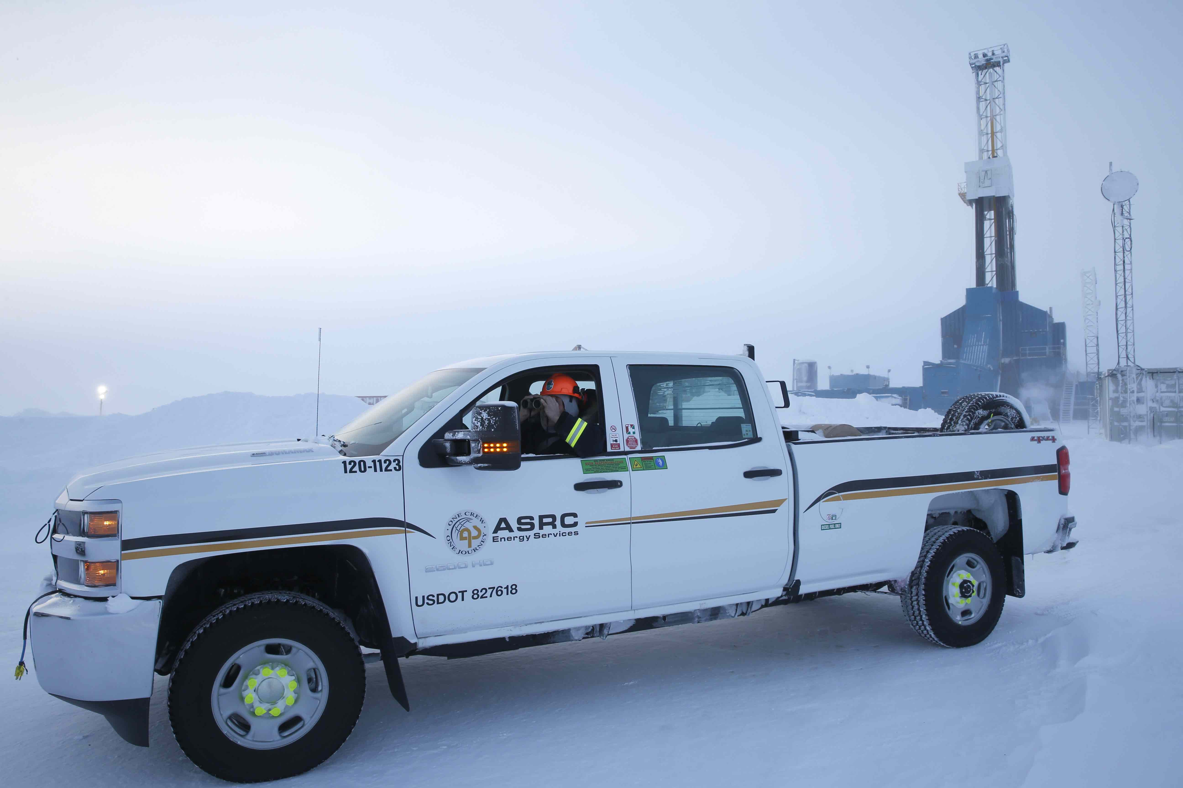
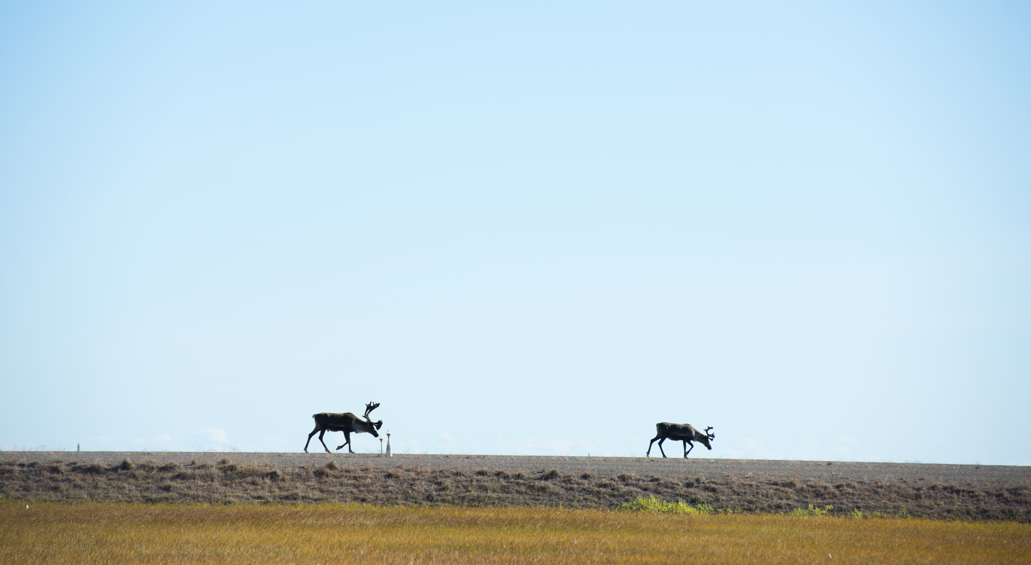
Outline
Local Collaboration – Fundamentals, Realities, & Benefits
Hybrid Collaboration in the Alaskan Arctic – Layers of Engagement
Case Studies
Conclusions
Local Collaboration in Alaskan Arctic Developments

Slide 3
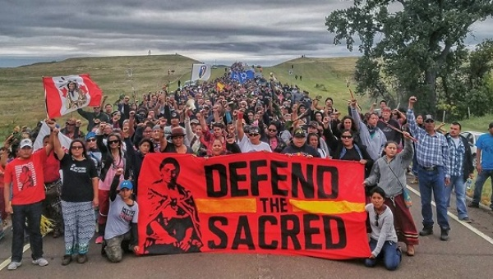
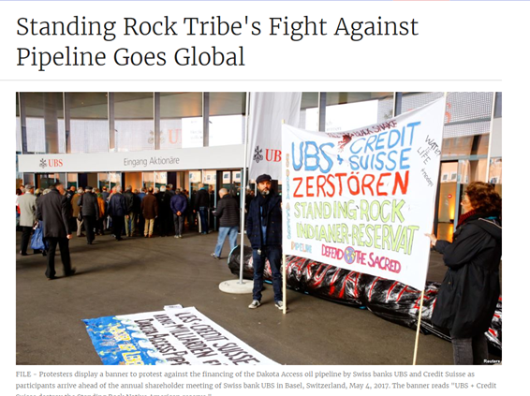
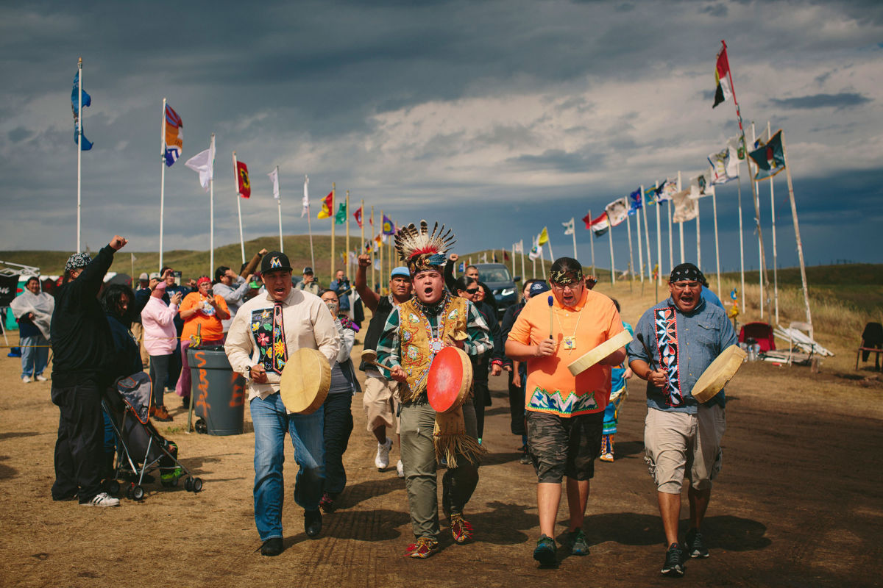
What is local collaboration?
Beyond consultation
Meaningful engagement
Ability for local stakeholders to have input & influence on local development
Opportunity to build local capacity, spur economic benefits, and offset negative impacts
Why is it important?
Local Collaboration in Alaskan Arctic Developments

Slide 4
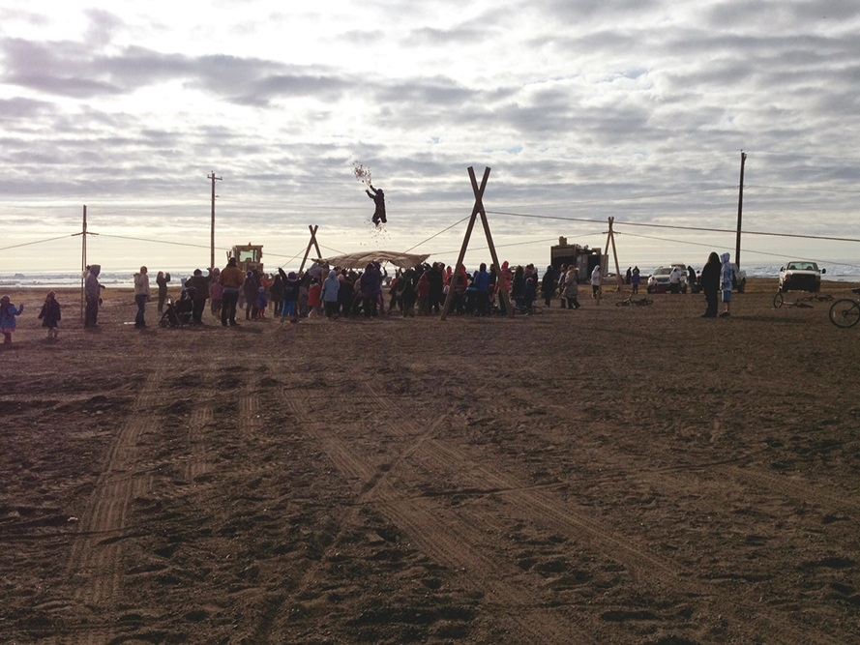
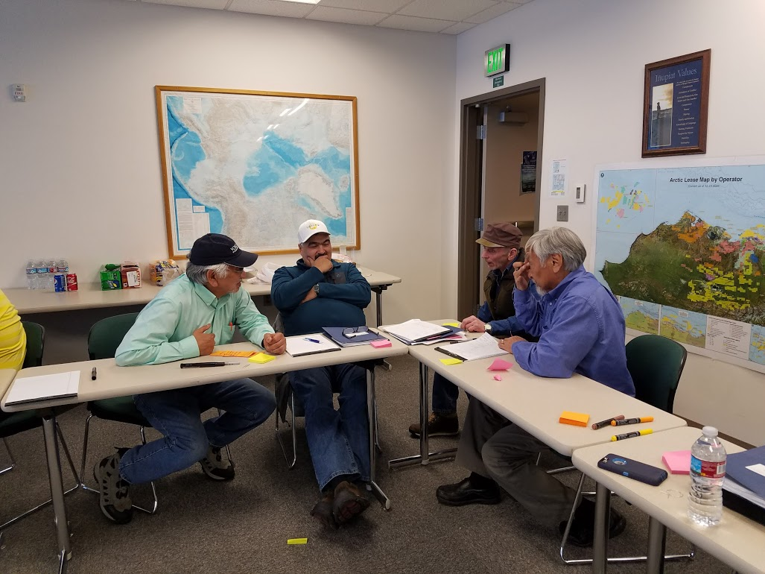
What are the benefits of successful local collaboration?
Industry:
Traditional Knowledge
Local Buy-In
License to operate
Reduces impacts locally
Agency:
Fulfills consultation obligations
Streamlines permitting process
Balanced mitigation
Builds relationship of trust
Stakeholder:
Empowers communities and indigenous peoples
Builds capacity
Economic and Socio-economic benefits
Local business development
Local Collaboration in Alaskan Arctic Developments

Slide 5
Hybrid Collaboration in the Alaskan Arctic
Layers of Indigenous Engagement:
Indigenous Land & Resource Management
Private-to-Private Partnerships
Community-based Non-Government Organization (NGO)
Public-to-Public
Co-management entity
Examples of Indigenous Engagement:
Regional Alaska Native Corporation – ASRC
Private Entity– Arctic Iñupiat Offshore, LLC (AIO)
Non-profit NGO – Voice of the Arctic Iñupiat (VOICE)
Public Partnership – NPRA Working Group (NPRA WG)
Local Collaboration in Alaskan Arctic Developments

Slide 6
Case Study #1: Regional Indigenous Resource Management
Arctic Slope Regional Corporation – ASRC
Alaska Native Corporation (ANC) established in 1971 by the Alaska Native Claims Settlement Act (ANCSA).
In Alaska, ANCs are the indigenous land and mineral owners.
44 million acres distributed to Alaska Natives through ANCSA; as the Regional ANC, ASRC received ~5 million acres on the North Slope.
ASRC owns the subsurface rights to many prolific resources across the North Slope like:
Oil in ANWR
Oil in NPRA
Coal in Western Arctic
Local Collaboration in Alaskan Arctic Developments

Slide 7
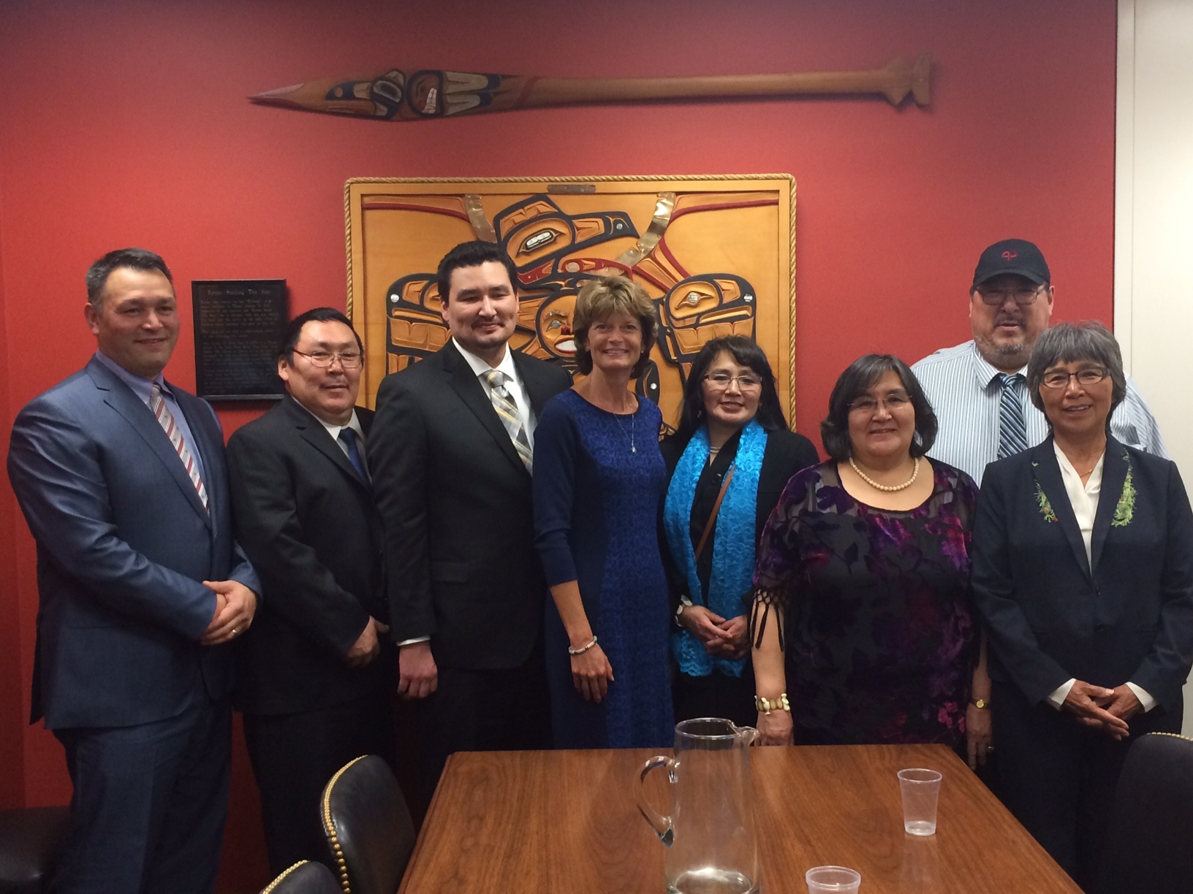
Case Study #1: ASRC cont’d
Arctic Slope Regional Corporation – ASRC
Goals:
Enhance economic self-determination
Build industry collaboration
Advocate for community needs
Engage in Arctic policy
Protect Iñupiat way of life.
Local Collaboration in Alaskan Arctic Developments

Slide 8
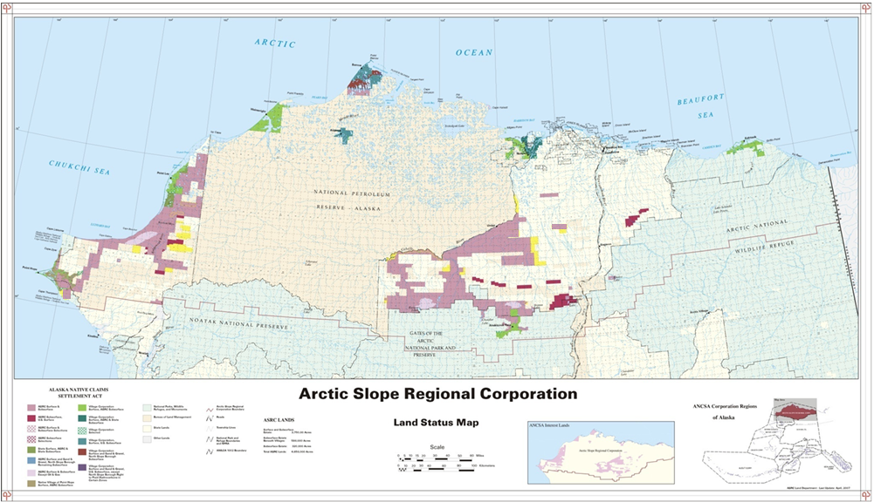
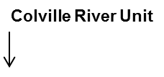
Case Study #1: ASRC cont’d
Condition of access to ASRC minerals included benefits to local community like Natural Gas to community of Nuiqsut
Western Arctic Coal
Established MOUs for impact mitigation, business development, conflict avoidance, and subsistence access.
Local Collaboration in Alaskan Arctic Developments

Slide 9
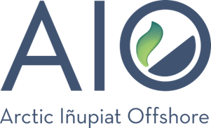
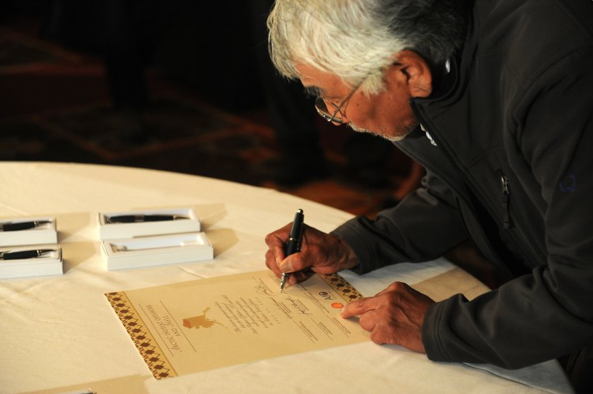
Case Study #2: Private-to-Private Partnership
Arctic Iñupiat offshore, LLC – AIO
Established in 2014 as an agreement between Shell, 6 Alaska Native Village Corporations, and ASRC.
Mechanism for local people to share in the rewards of offshore resource development and have a seat at the table for future activities in the Arctic region.
Goals:
Education
Advocacy (local, federal, and public)
Build local capacity
Economic benefit
Safeguard subsistence
Local Collaboration in Alaskan Arctic Developments

Slide 10
Local Collaboration in Alaskan Arctic Developments

Slide 11
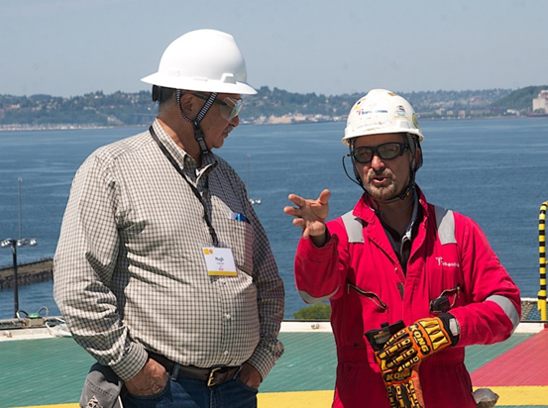
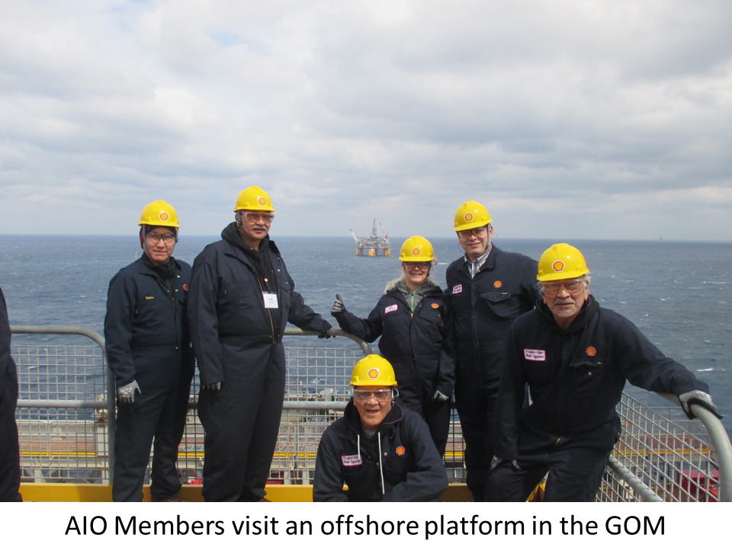
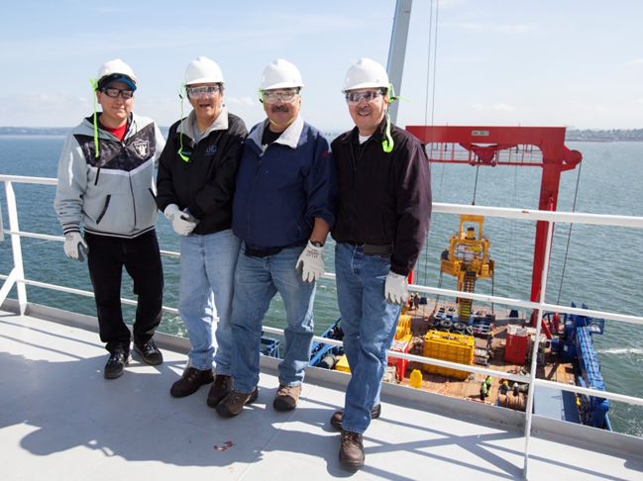
Case Study #2: AIO cont’d
What does “seat at the table” look like?
Enhance local stakeholders role and oversight in development occurring in the Arctic OCS.
Operations
Spill Response
Subsistence
Permitting
Advocacy
Local Collaboration in Alaskan Arctic Developments

Slide 12
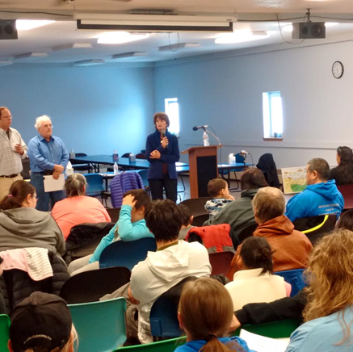
Case Study #3: Community based NGO
Voice of the Arctic Iñupiat – VOICE
Local non-profit composed of diverse North Slope leadership.
Local representation for local issues.
Trickle up strategy for Arctic policy decisions; VOICE was designed to amplify the voice of local people.
Goals:
Strengthen North Slope
Raise awareness on Arctic issues
Encourage sound subsistence management
Support safe and responsible resource development
Identify and address social issues
Local Collaboration in Alaskan Arctic Developments

Slide 13
Local Collaboration in Alaskan Arctic Developments

Slide 14
Case Study #3: Community based NGO cont’d
Voice of the Arctic Iñupiat – VOICE
VOICE Snapshot:
Inform local community on proposed ANWR legislation, act as a conduit to represent community interest and concerns on opening ANWR for resource development.
Engage policy makers at Federal, State, and local levels on issues which impact subsistence and the local economy, such as proposed Ivory Bans.
Track mitigations and restrictions to subsistence, like the U.S.-Russia Bilateral Polar Bear Treaty.
Conduct community based surveys on the local economy, resource development, and community development concerns to identify and address issues.
Local Collaboration in Alaskan Arctic Developments

Slide 15
Case Study #4: Federal-Local Co-management
NPRA Working Group
Agency founded group with local indigenous leadership to co-manage the resource and habitat rich North Slope.
Makeup: Tribes, local government, Village Corporations, ASRC, and federal agency.
Goals:
Oversee responsible resource development in the NPRA
Represent community concerns to agency and industry
Discuss reasonable mitigation
Influence project development and permitting process
Provide local input on Federal Land Management decisions
Local Collaboration in Alaskan Arctic Developments

Slide 16
Summary
Key takeaways
Layers of local collaboration
Indigenous peoples in Alaska have worked to create various mechanisms to manage and promote local influence on Arctic resource development with industry and agency partners.
Goal is for Arctic activities to be determined by Arctic peoples.
Proactive Engagement is important to transition from being a bystander to being a credible and valuable stakeholder.
Local Engagement
Local Collaboration
Locally Driven
Development
Why is it important?
Seat at the table
Steer culturally responsible & environmentally safe development
Participate in permitting & policy decisions
Economic benefit
Build local capacity
Indigenous self-determination
Local Collaboration in Alaskan Arctic Developments

Slide 17
Quyanakpuk
Quyanaqpak!
Taikuu

