Slide 1
Make your voice heard: Engaging in Federal Decision-making including Environmental Impact Assessments
Wendy Loya
Coordinator, wendy_loya@fws.gov
Paul Leonard
Science Coordinator, paul_leonard@fws.gov

Slide 2
What are the things you value most?
Food Security
Economic Security
Public Safety
Healthy Family
What changes on the lands around you could impact those values, for better or worse?

Slide 3
Process for Environmental Impact Assessment under NEPA

Slide 4
Managing Alaska’s Natural Resources
Notes:
How many of you live in a place nearby or surrounded by federal land? Or perhaps near a proposed large project, like a mine, that requires permits from the federal government?

Slide 5
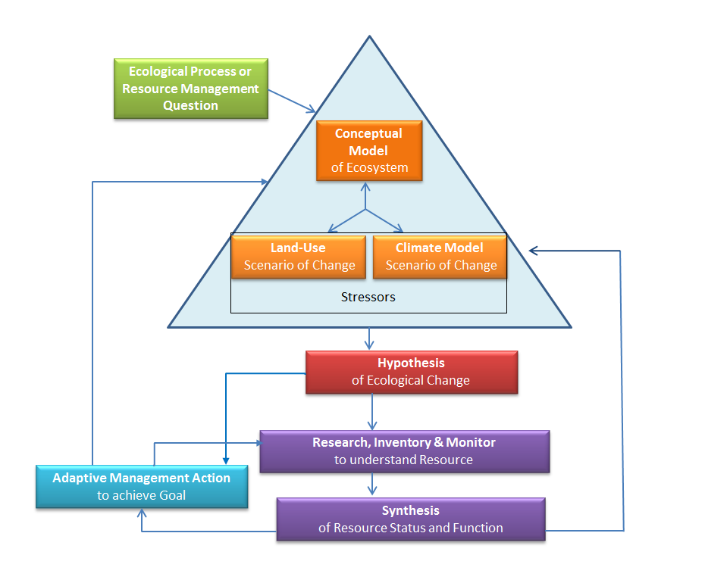
Figure by Wendy Loya

Slide 6
Multiple Plausible
Scenarios for each component
Interactions =Cumulative Effects

Slide 7
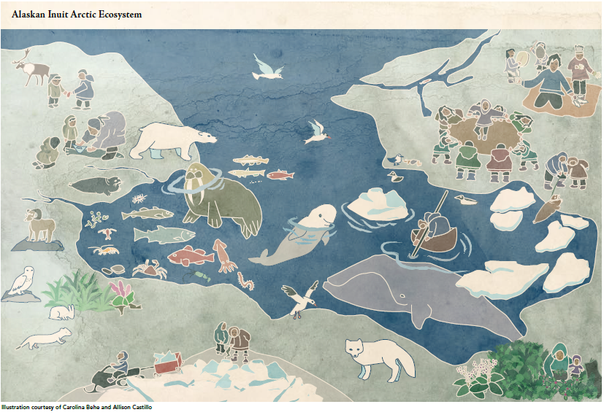
Conceptual Model of an Ecosystem: interdependence of everything INUIT CIRCUMPOLAR COUNCIL-ALASKA ALASKAN INUIT FOOD SECURITY CONCEPTUAL FRAMEWORK

Slide 8
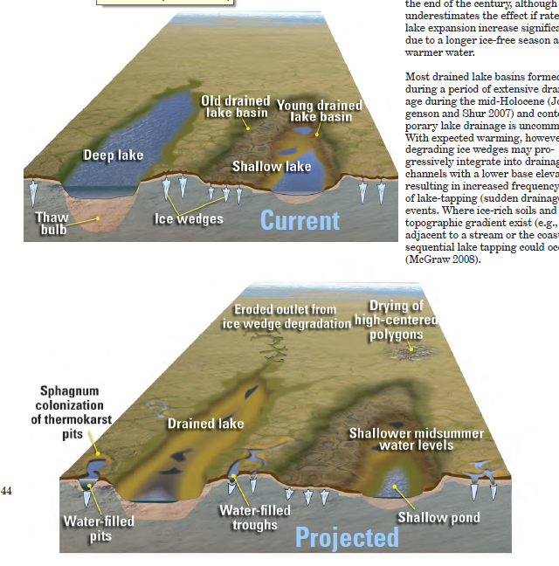
Micro-topography makes a difference for habitat

Slide 9
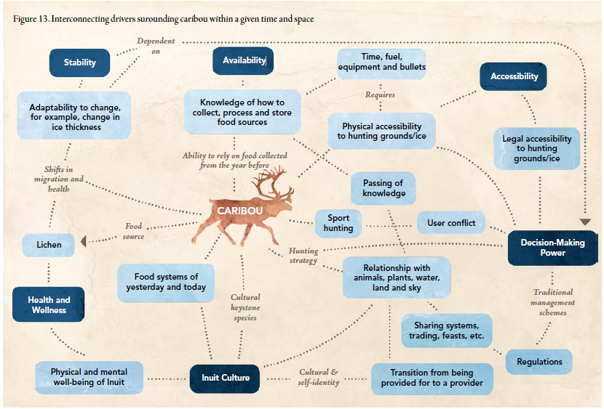
How will management decisions impact what you value?

Slide 10
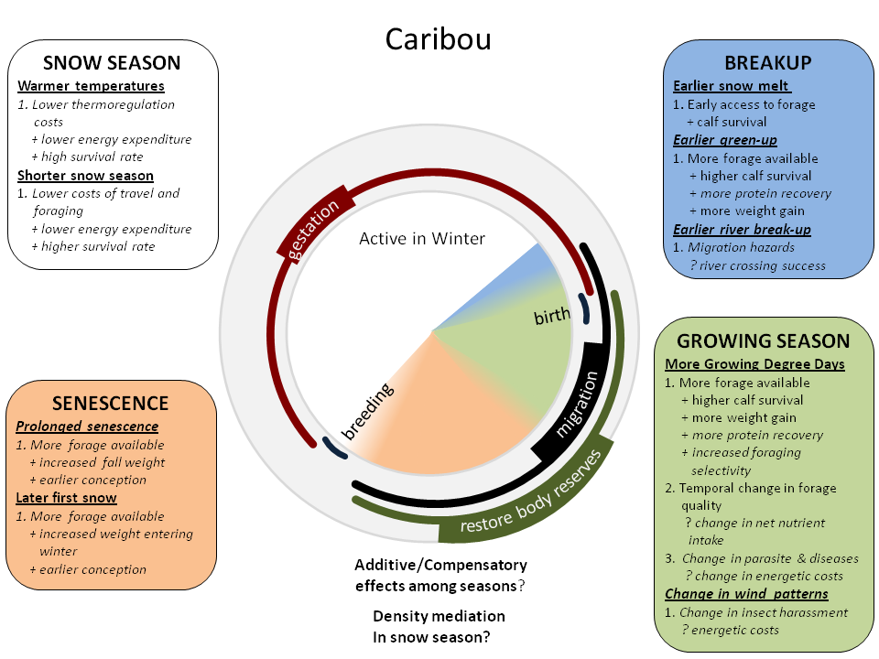
Conceptual Model of climate impacts on Caribou
Conceptual models in Arctic LCC Species and Habitat Working Group

Slide 11
What would we need to know to predict development impacts on caribou & hunters?
Knowledge on where communities hunt caribou seasonally
Understand which habitats caribou use when
Understand how climate change might shift habitats to new locations
Understand how hunters respond to development/infrastructure in hunting areas
Model of how and where development might occur
Knowledge on how caribou respond to development and human activities
Estimate of the Positive and/or Negative of Development on caribou and hunters

Slide 12
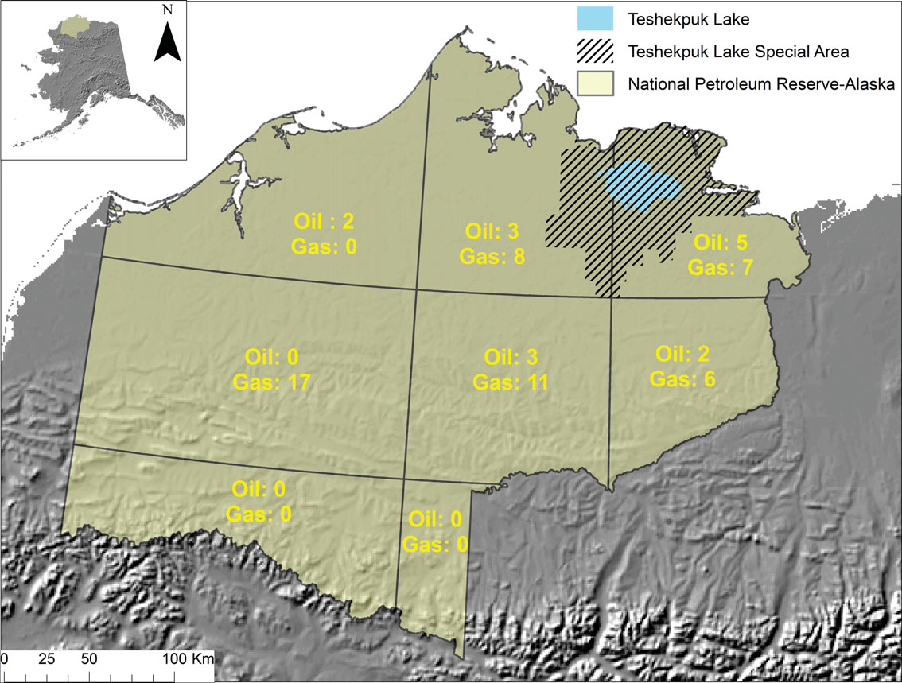
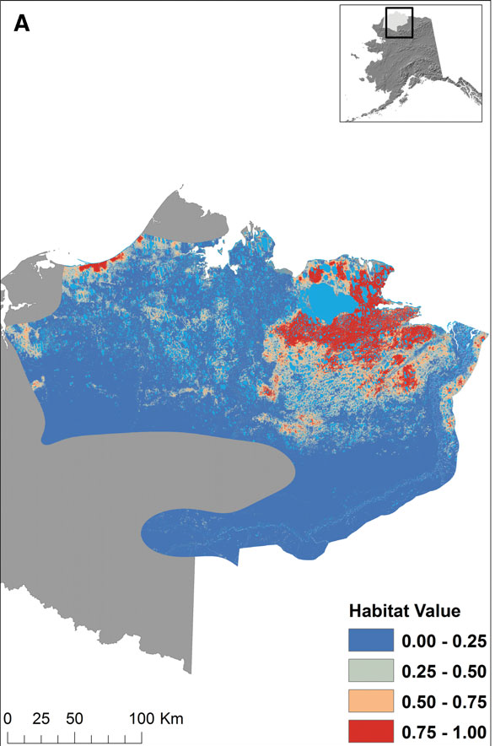
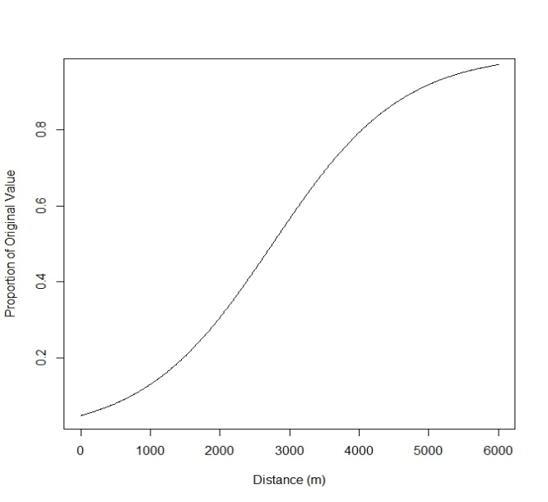
Understand which habitats caribou use when: Calving Habitat for Teshekpuk Lake Herd
Model of how and where development might occur (BLM NPRA IAP 2012, USGS NPRA Econ. Assess. 2011)
Knowledge on how caribou respond to development and human activities: Caribou with calves response to roads (Cameron et al. 2005)

Slide 13
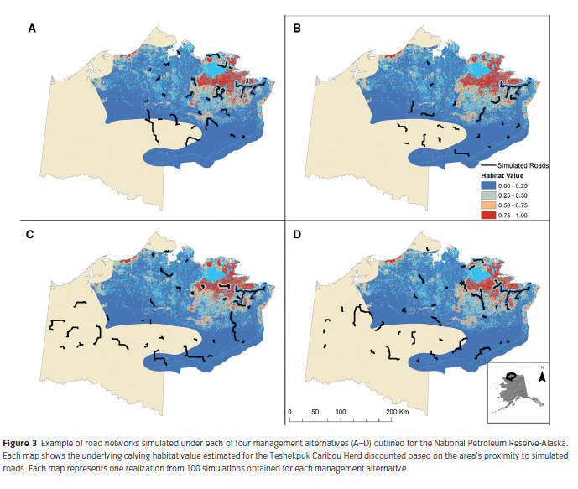
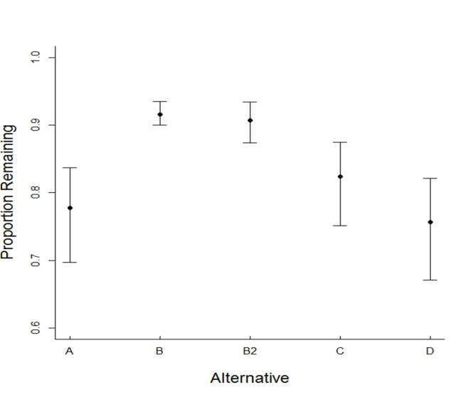

Slide 14
What would we need to know to predict development impacts on Food Security?
Knowledge on where communities hunt seasonally
Understand which habitats species use when
Understand how climate change might shift habitats to new locations
Understand how hunters respond to development/infrastructure/shipping in hunting areas
Model of how and where development might occur
Knowledge on how species respond to development and human activities
Estimate of the Positive and/or Negative of Development on species and hunters

Slide 15
Opportunity and Need for local knowledge in landscape scale planning

Slide 16
Summary
Convey what you value to resource managers
Explain how a proposed action might diminish that value, and/or ask for the agency to evaluate the impacts and tell you what is likely to happen
Ask how the agency will monitor the impacts and when they will share results with your community. Better yet, see if they will engage local observers!

